Slide 1
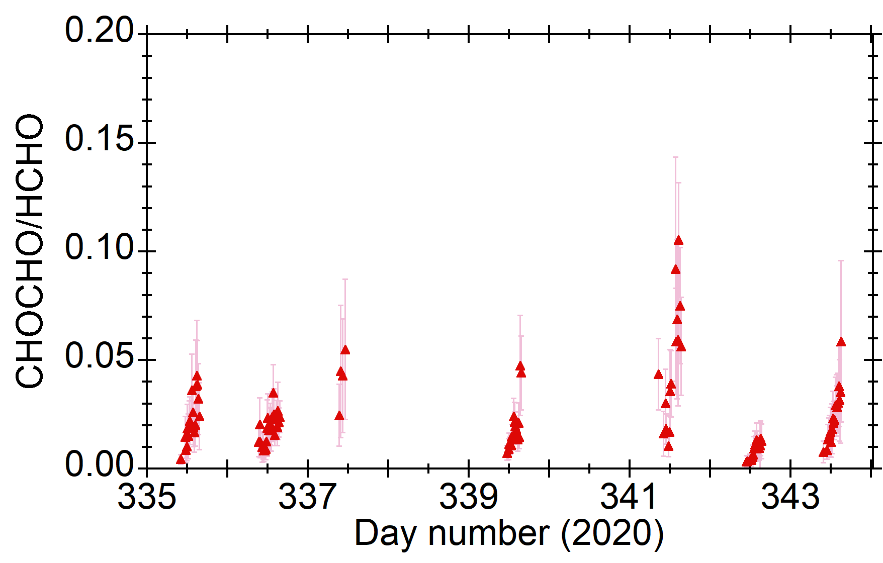
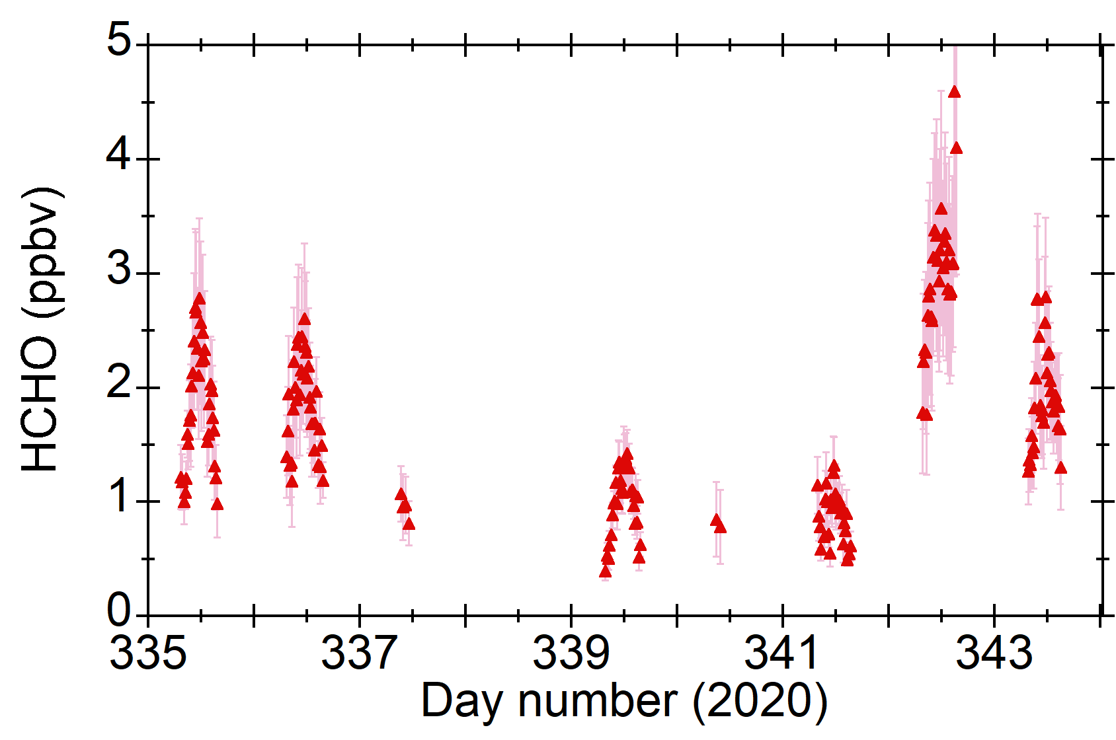
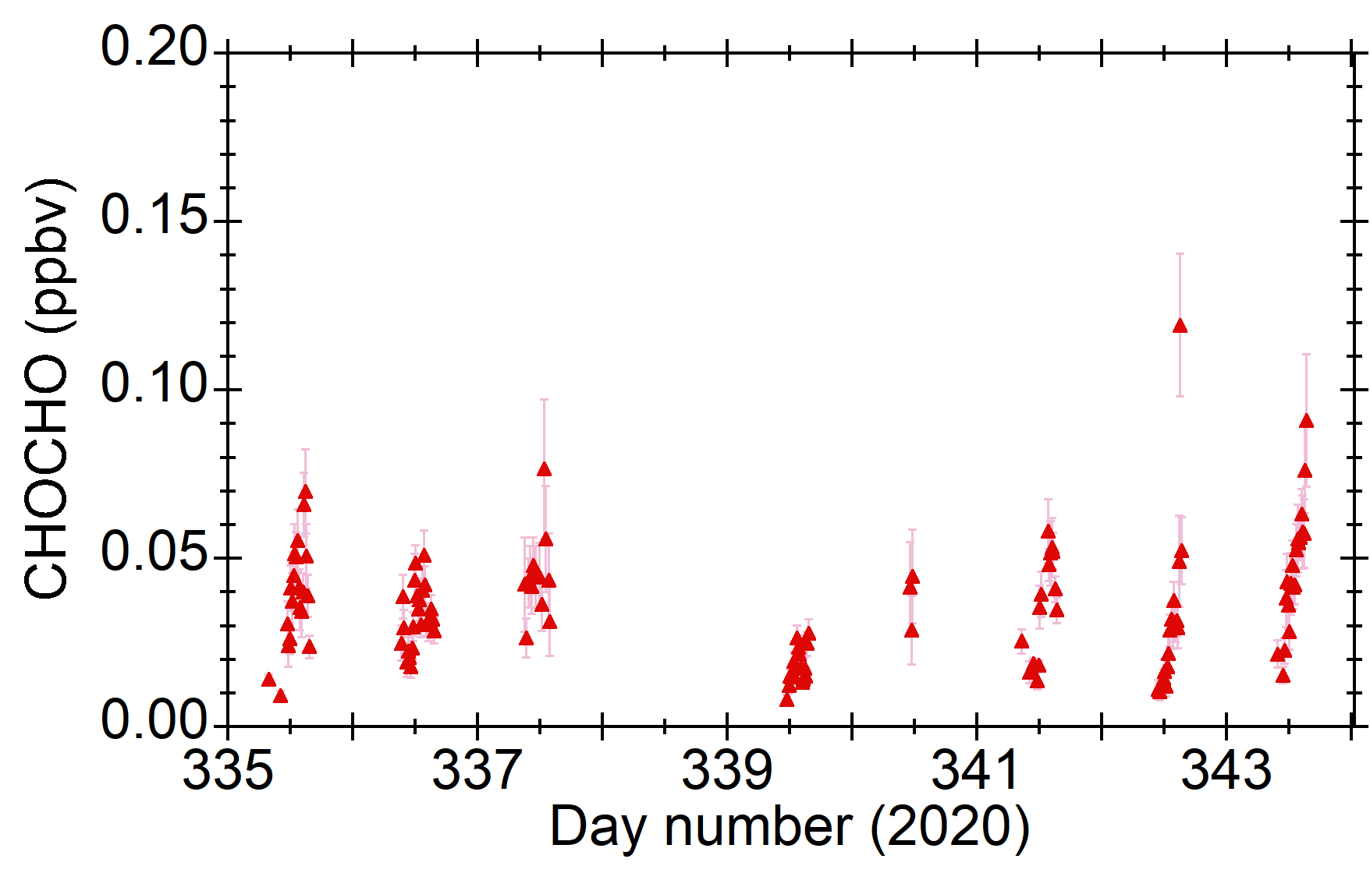
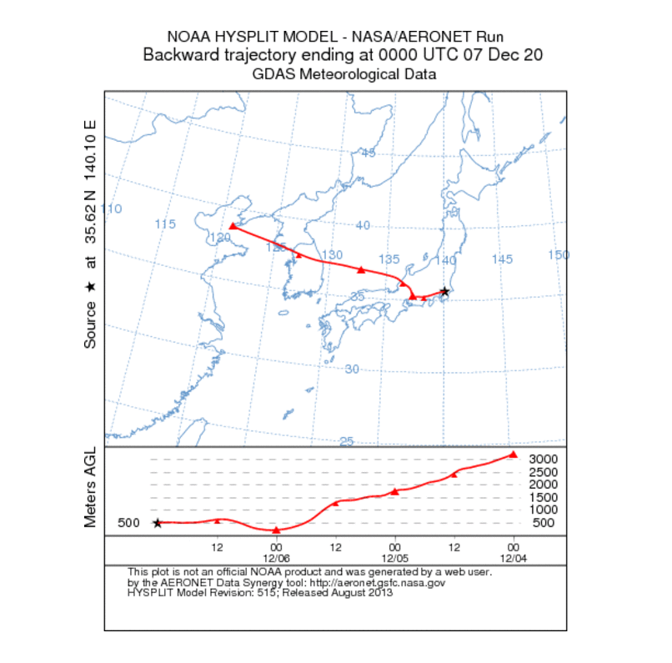
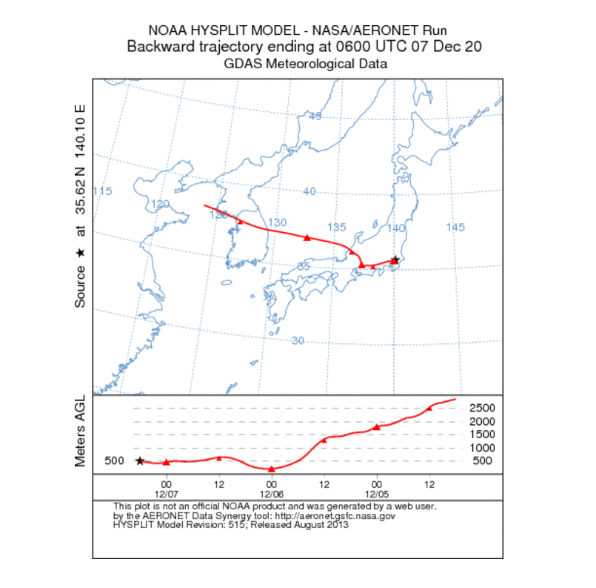
HCHO, CHOCHO, & R_{GF} (MAX-DOAS #1)
Nov.30
Dec. 7
biogenic
anthropogenic
from 9 JST
from 15 JST
HYSPLIT back trajectory

